Slide 1
AGRO – Agricultural Management System
CHIRAG GUPTA (19Z207)
DARWIN DEBBARMA (19Z208)
JASWANTH KRISHNA V (19Z220)
KOUSHIK BALAJI P (19Z223)
SIVASUBRAMANIAM J (19Z244)
VARUN BHARADWAJ (19Z256)

Slide 2
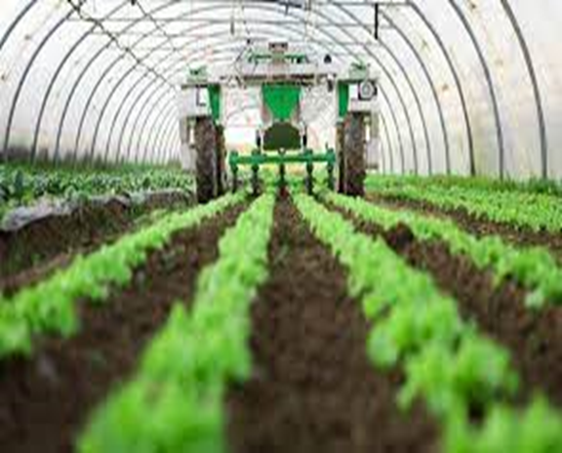
Introduction
In today’s situation, Farmers are in need of appropriate support to improve their standard of living and also their quality of crop production.
This web application, AGRO helps farmers to sell their produce for the price they deserve and it also promotes quality crop production.
This application is designed and built for Farmers, NGOs that are interested in helping Farmers and organizations/ministries that intend to help farmers.

Slide 3

Problem Statement
This web application, AGRO is designed to be a standalone system that might replace the current ways of selling produce and help reframe the method of payment for farmers.
This system’s aim is to ensure that farmers are not exploited and the application is used in a widespread manner like a government funded app.
Moreover, this application is developed based on farmer’s perspective and help them to know important events on daily basis.

Slide 4
Objective
The objective of this system is to connect Farmers who sell their produce to their Buyers via an Auction Feature.
This ensures a appropriate pay for the Farmers, if not a higher price, for their produce.
It will include a feature to ensure Farmers to get insights on daily events with the help of News Feed Section.
Making a Union will also be possible if a group of farmers decide to cooperate and sell their Produce together.

Slide 5
Requirements Gathering
Security Requirement: Proper authentication is required for users to access any of the web pages.
Software Quality Requirement: Users should not have a hard time trying to navigate the site. Navigation links should be consistent and clearly labelled. All navigation links should also be working properly and should point to the intended page/site.
Language Constraint: Supported Language is English only.
Database Requirements: All details stored in database must be in synchronization with the application so that it is consistent.
Storage Requirements: Data of maximum 10 GB can be stored in Database Server.

Slide 6
Modules
01
02
03
04
Seasons and Produce
Auction Feature
Union Making
This portal gives details about the kinds of seasons and the kinds of crops that can be cultivated
Farmers can sell their goods through Auction Methodology which yields pay for their produce
This portal provides options for the farmers so that they can collaborate and sell their goods together.
05
News Feed
Help and Support
This feature tells about the new Schemes and Subsidies introduced by the farmers.
This portal help Users to clarify their queries where they can send their details along with queries

Slide 7
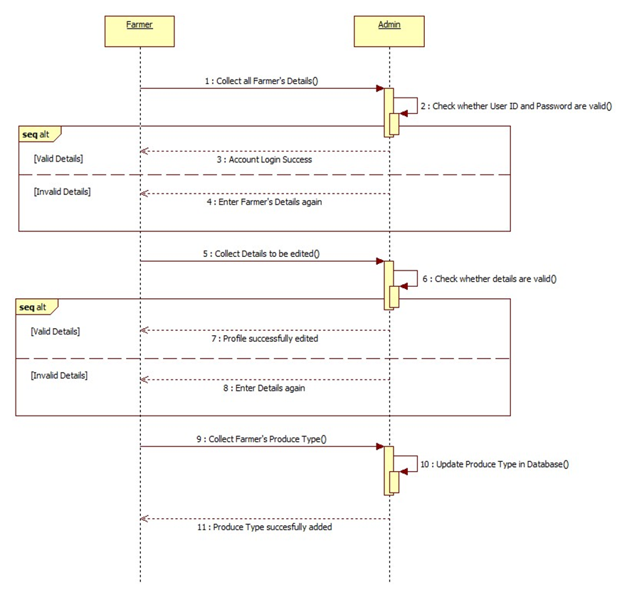
System Architecture - SEQUENCE DIAGRAM:
Register and Login Functionality

Slide 8
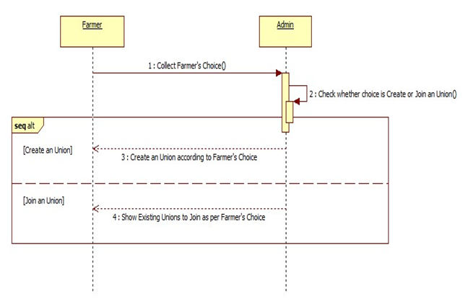
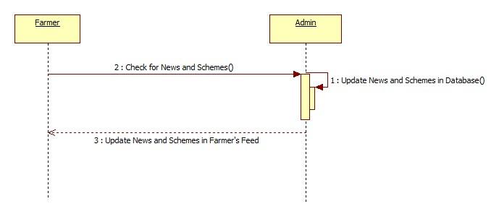
System Architecture
Union Functionality News Feed Functionality

Slide 9
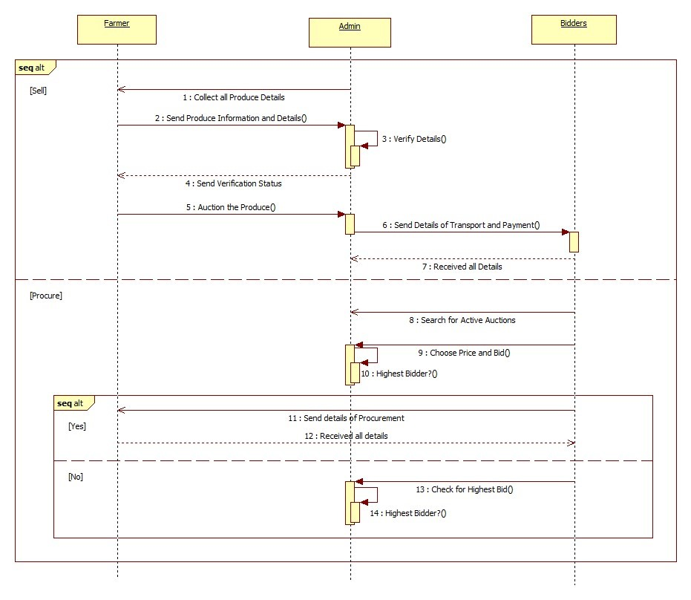
System Architecture
Auction Functionality

Slide 10
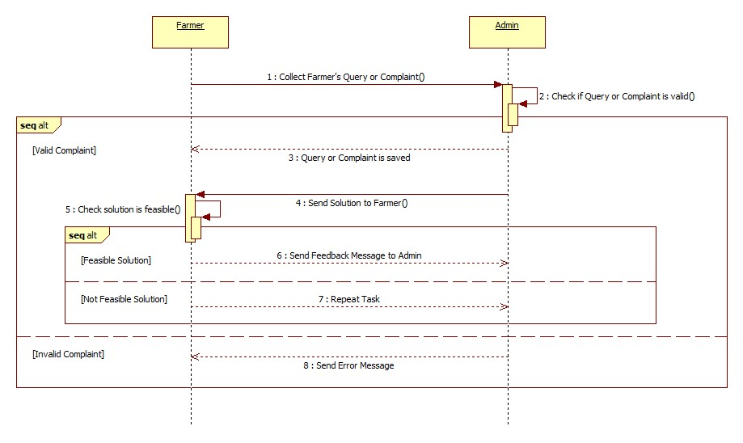
System Architecture
Help and Support Functionality

Slide 11
Software Requirements
Hardware Requirements
Front-End Development: HTML, CSS, JavaScript, EJS, Express and React
Middle-End Development: NodeJs and ReactJs
Back-End Development: Java
Databases: MongoDB and Firebase
Supported Platforms: Platforms at which this application can be operated are web browsers like Google Chrome, Mozilla Firefox, Brave, Safari, etc. and this web application works irrespective of Operating Systems.
The website will be accessible to users who use a computer with any OS specifications and also on smartphones which can allow access to location settings.
The nature of data will be both quantitative while used in auctions, granaries and e-commerce while it is also qualitative in case of schemes and subsidies, seasons interfaces.

Slide 12
Contribution of Team Members
CHIRAG GUPTA – News Feed Functionality
DARWIN DEBBARMA – Seasons and Produce Functionality
KOUSHIK BALAJI P – Union Functionality
JASWANTH KRISHNA V – Auction Functionality
SIVASUBRAMANIAM J – Register and Login Functionality
VARUN BHARADWAJ – News Feed Functionality

Slide 13
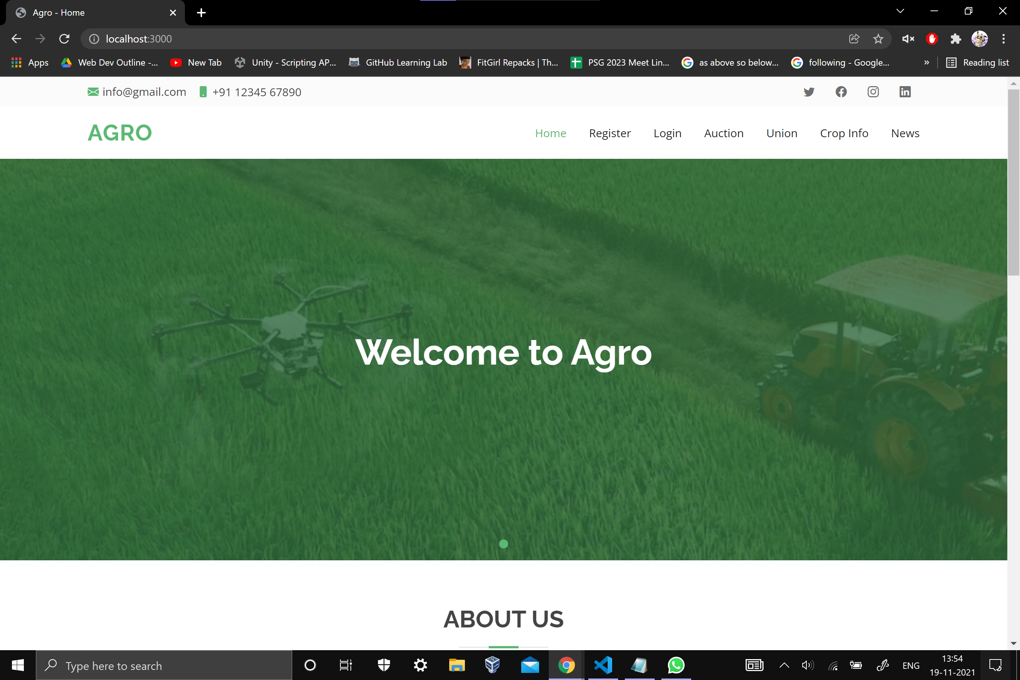
Demo Screenshots
Home Page

Slide 14
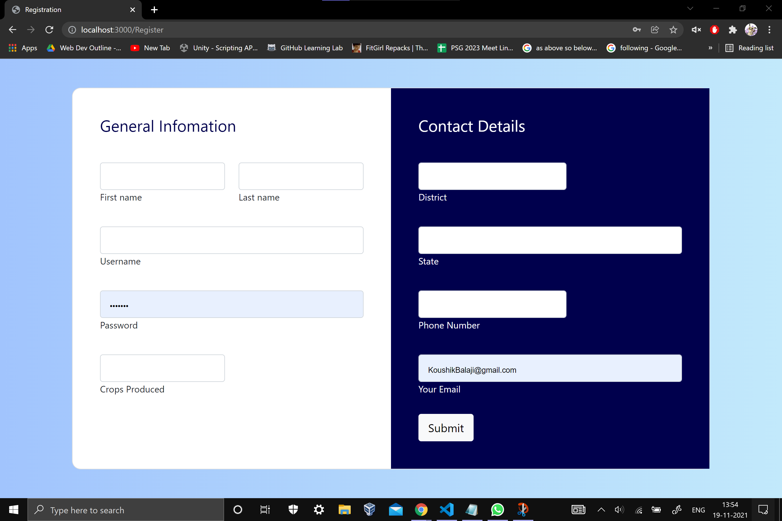
Demo Screenshots
Register Page

Slide 15
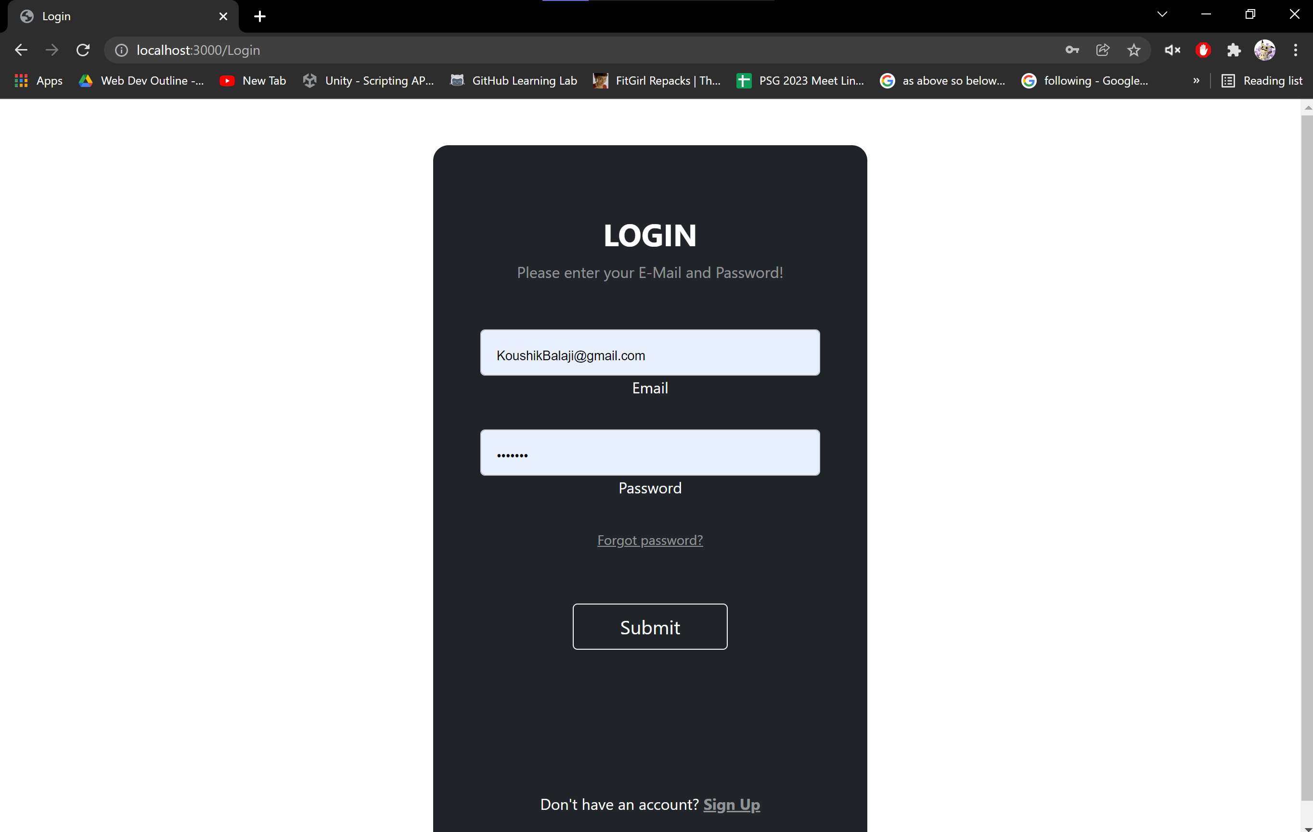
Demo Screenshots
Login Page

Slide 16
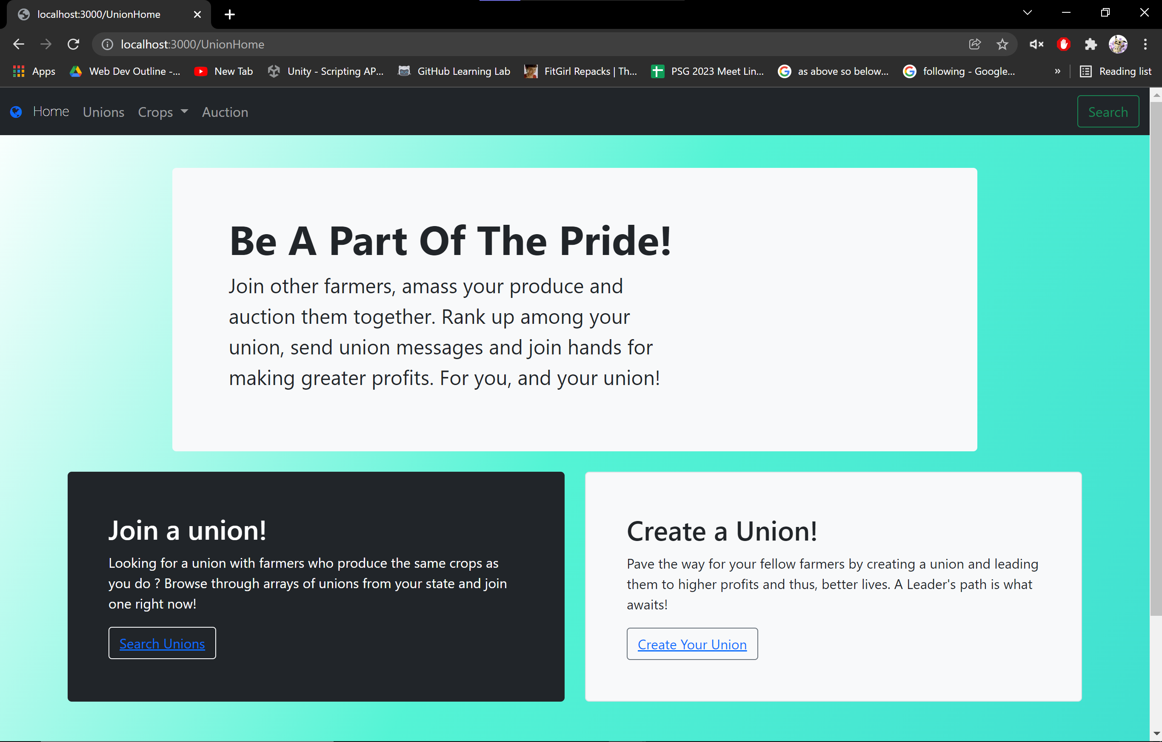
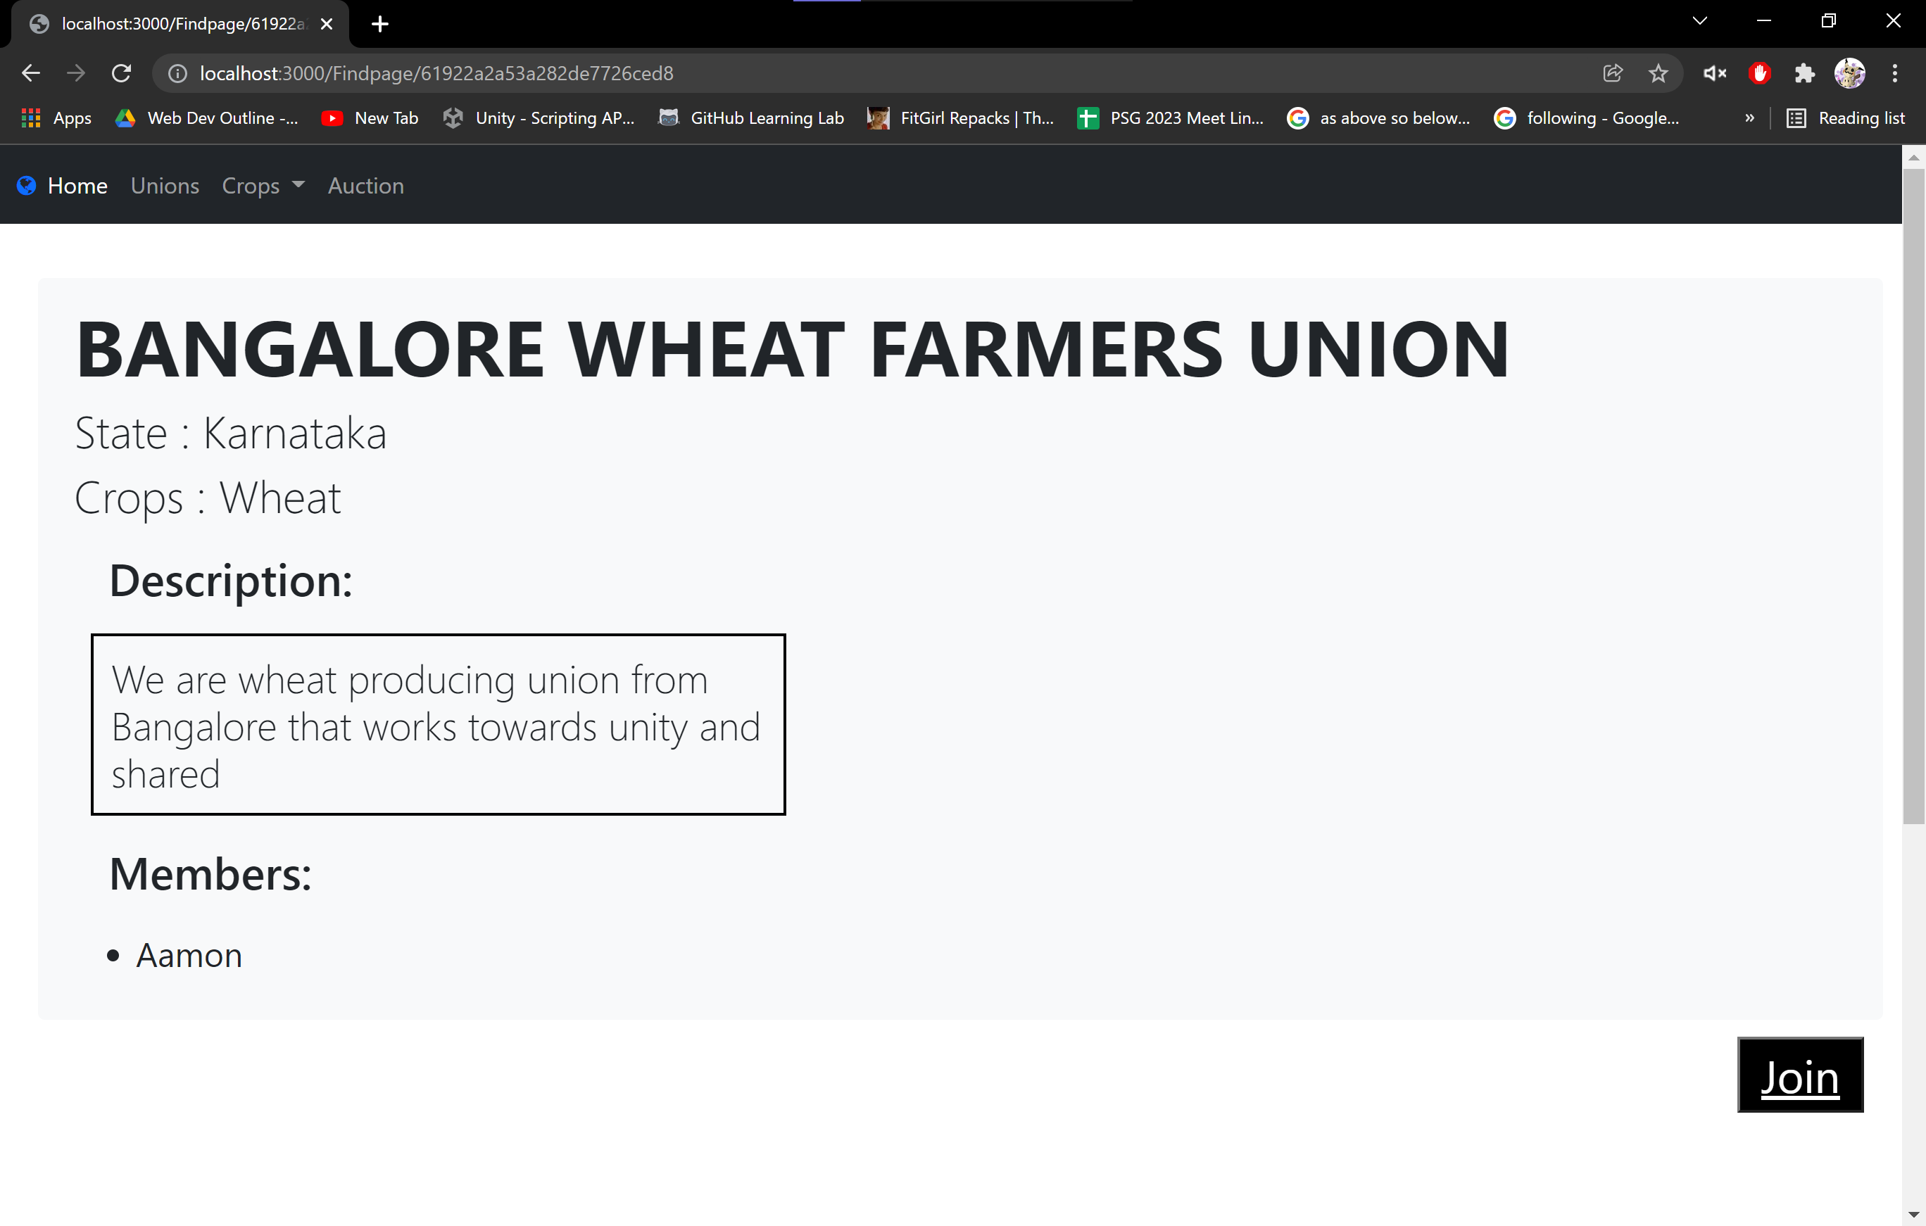
Demo Screenshots
Union Page

Slide 17
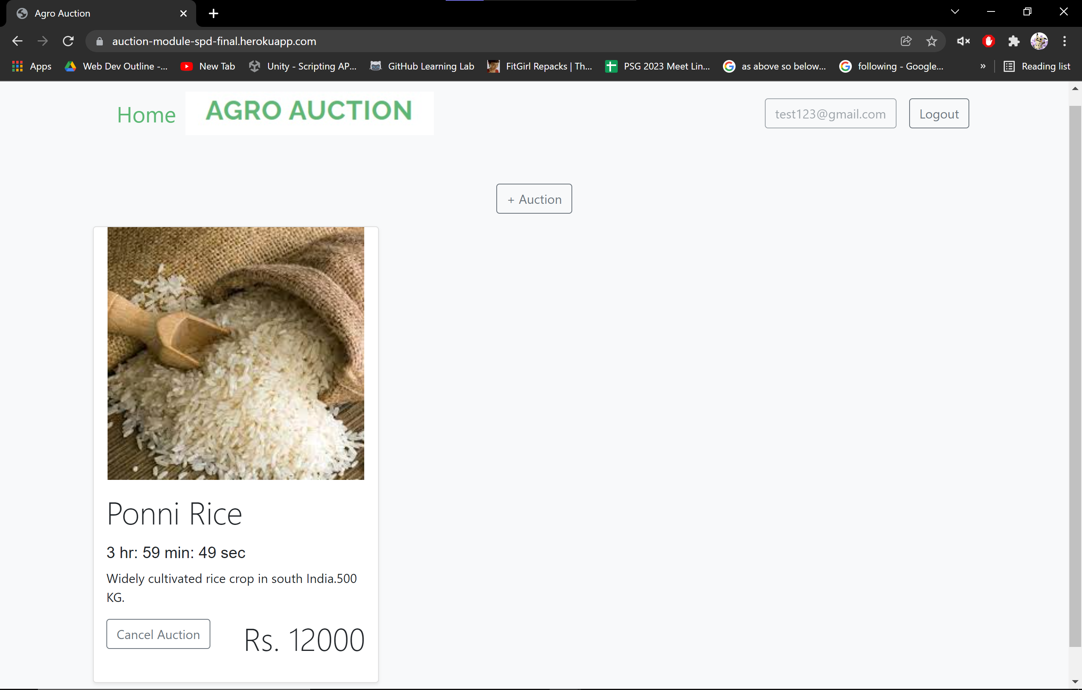
Demo Screenshots
Auction Page

Slide 18
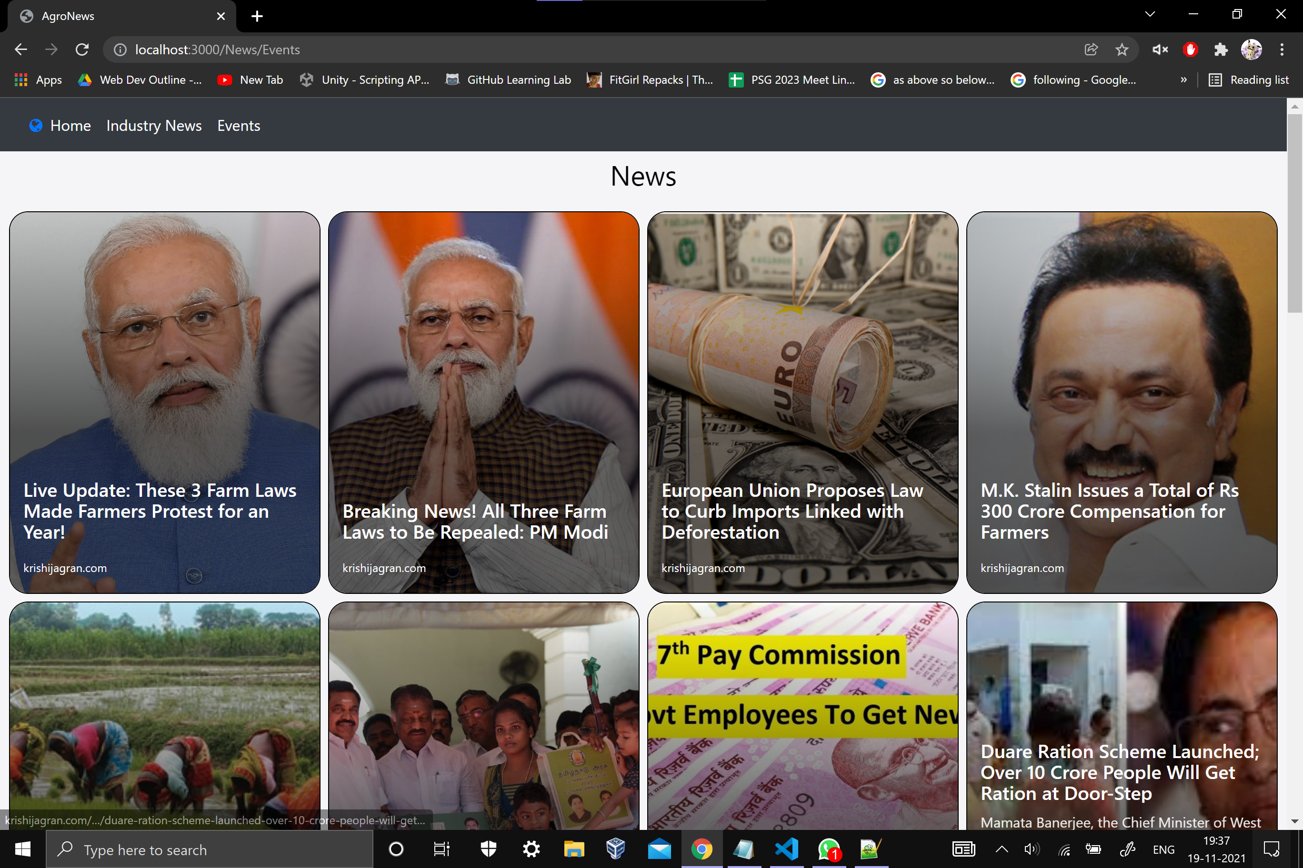
Demo Screenshots
News Feed Page

Slide 19
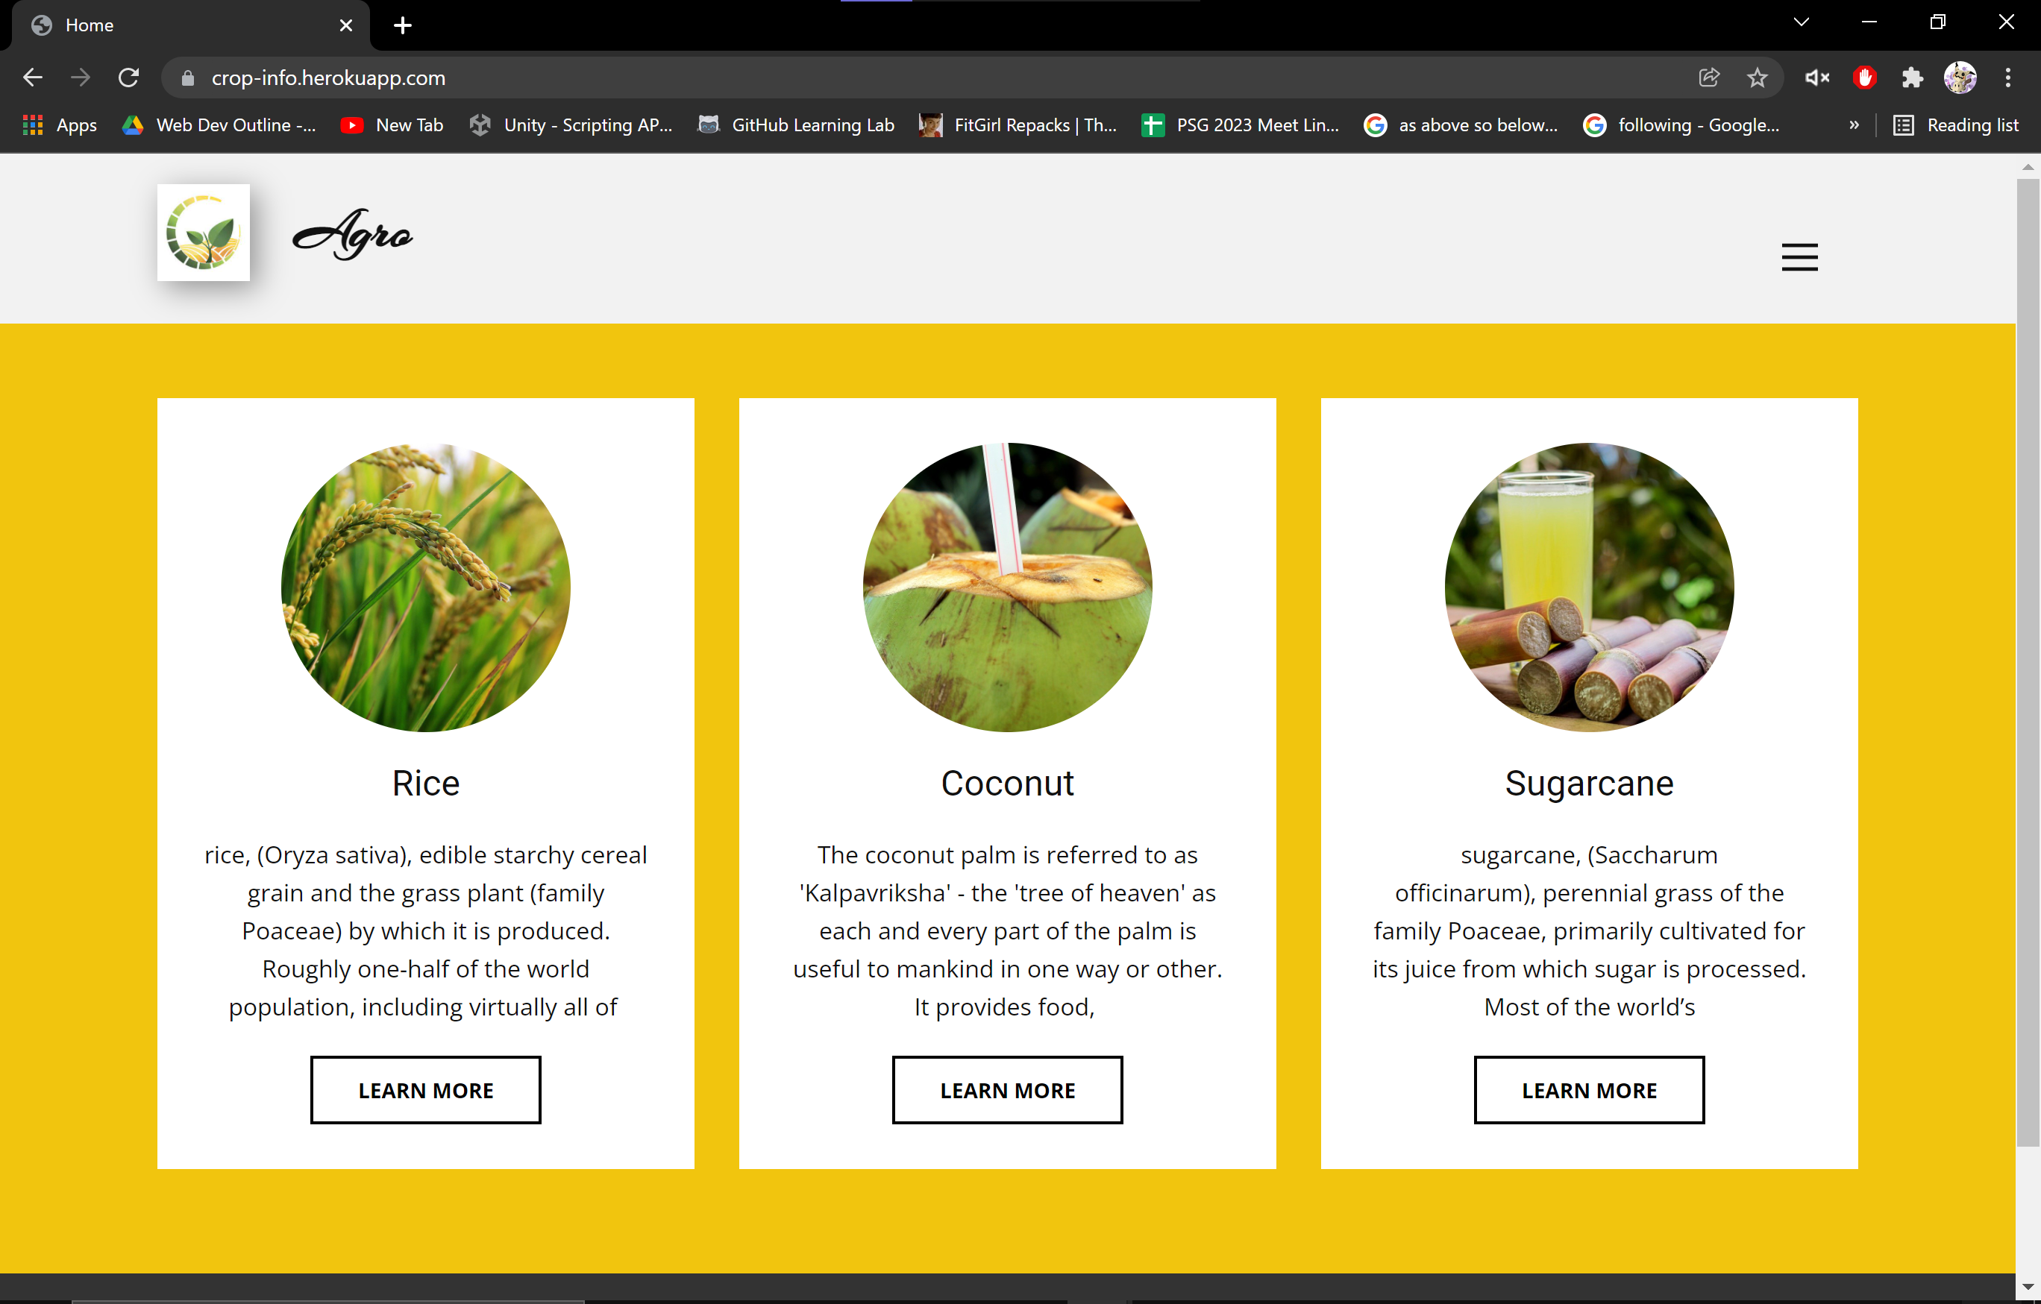
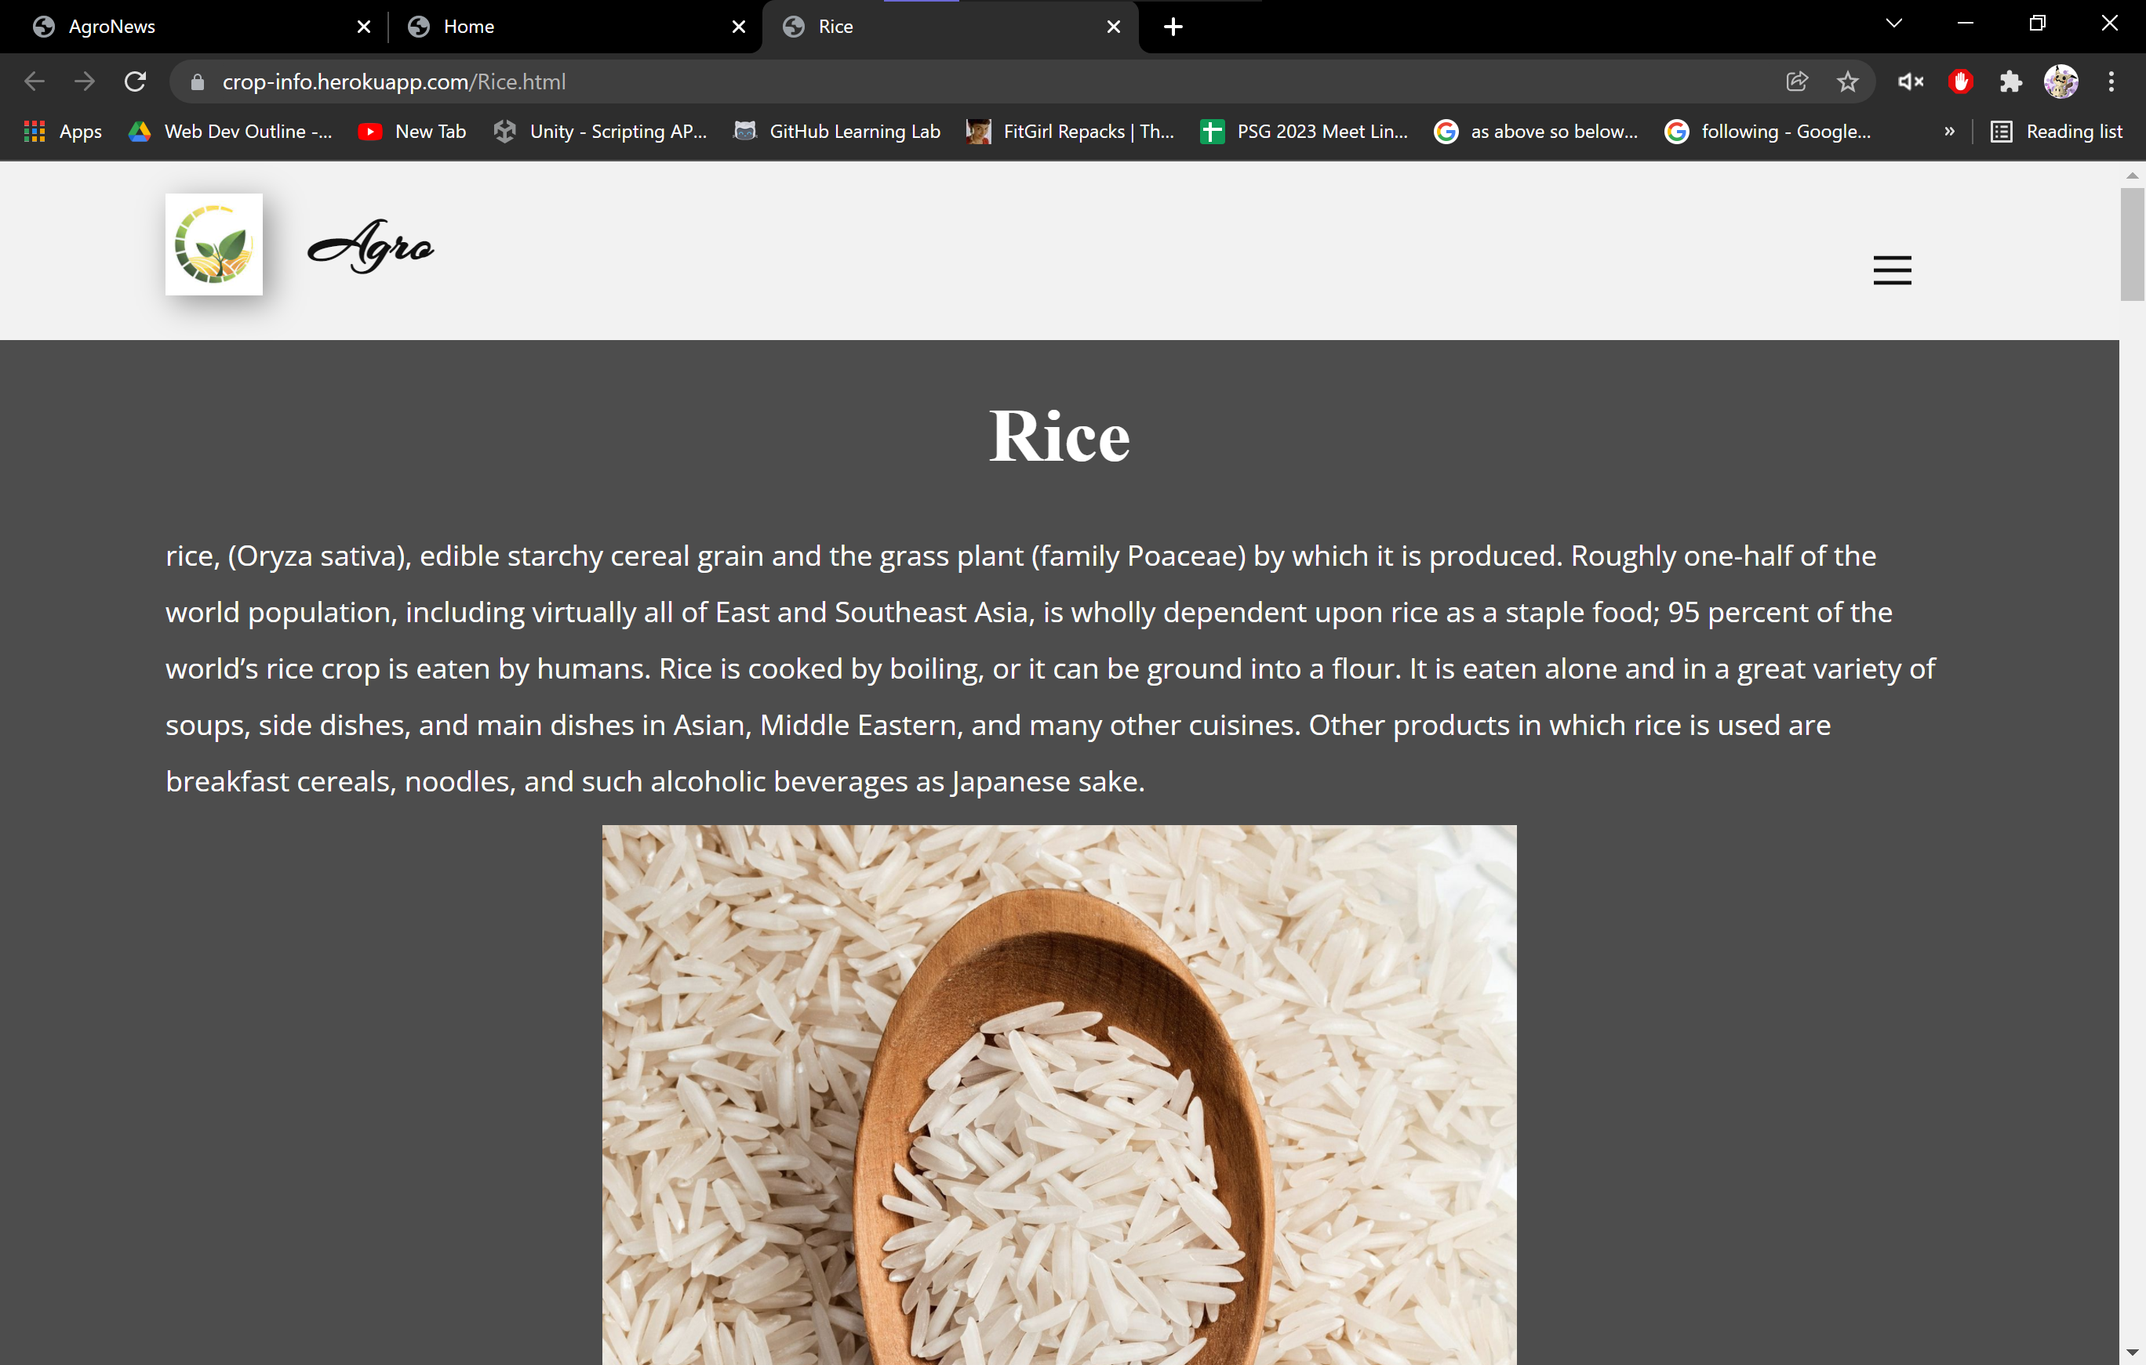
Demo Screenshots
Seasons and Produce Page

Slide 20
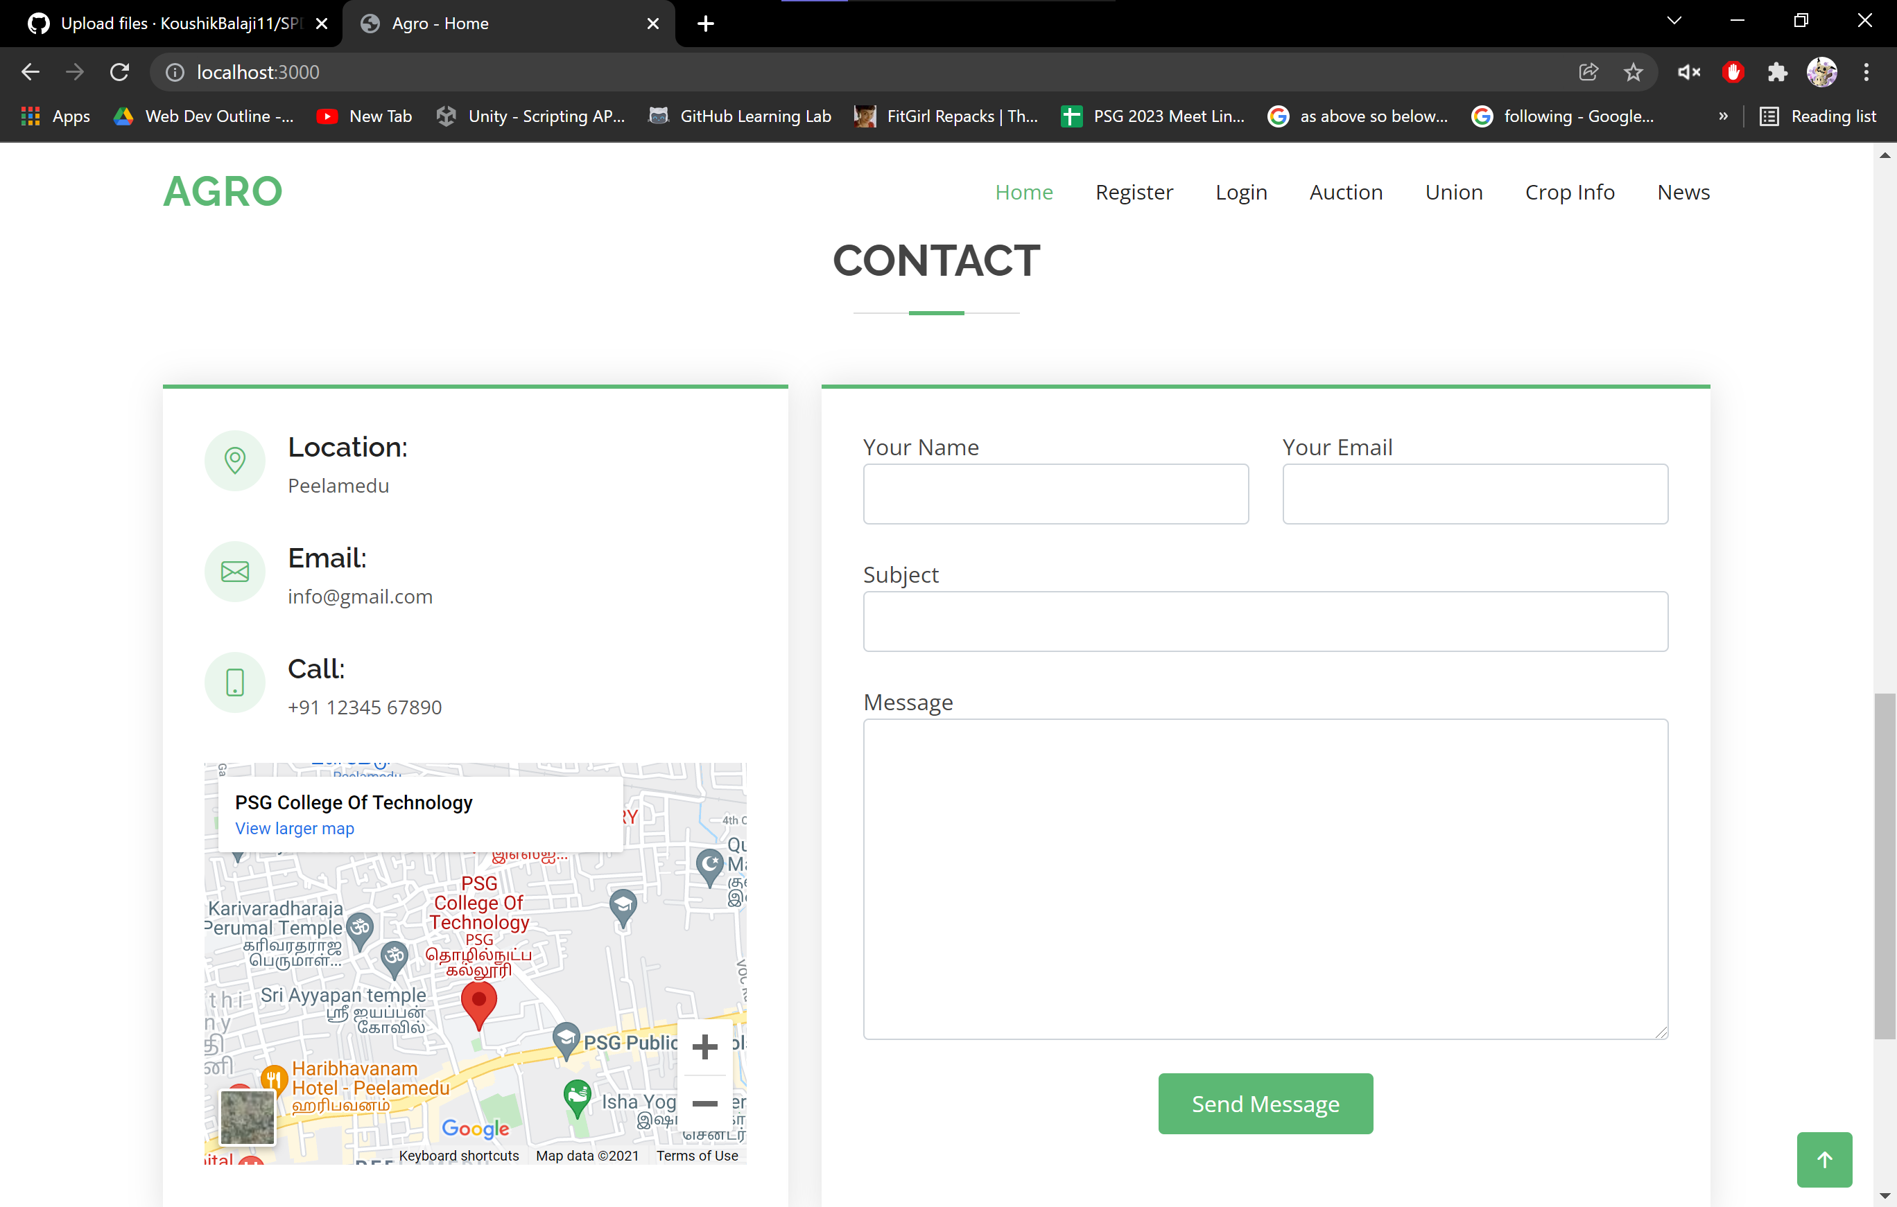
Demo Screenshots
Help and Support Page

Slide 21
THANK YOU!

